Slide 1
Senior Mental Health Lead training
MentalHealth.LeadTraining@education.gov.uk Senior mental health lead training - GOV.UK (www.gov.uk)
October 2022

Slide 2
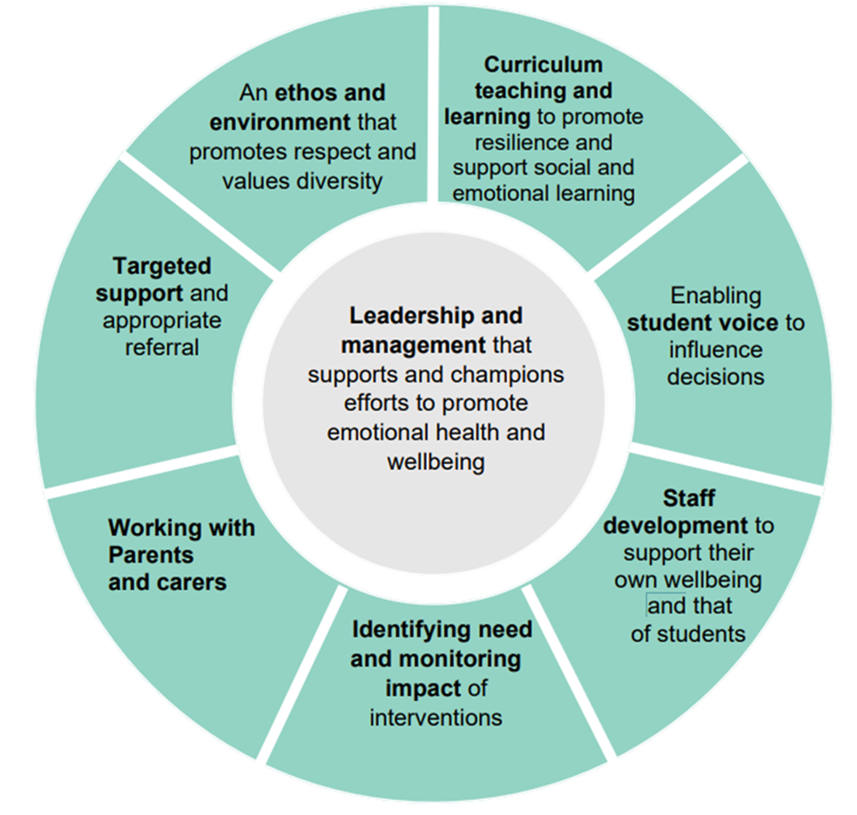
Did you know that the Department for Education is offering a grant of £1,200 for eligible state-funded schools and colleges in England?
This grant is to train a senior mental health lead to develop and implement a whole school or college approach to mental health and wellbeing.
This training is not compulsory, but it is part of the government’s commitment to offer this training to all eligible schools and colleges by 2025.
Training will help the strategic development of a setting's holistic approach to mental health and wellbeing.
The 8 principles of a whole school/college approach to mental health and wellbeing.

Slide 3


Senior Mental Health Lead role
A senior mental health lead is a strategic leadership role in a school or college, responsible for overseeing the setting’s whole school or college approach to mental health and wellbeing.
Identifying a senior mental health lead
Schools and colleges can decide who is best placed to take on the role of senior mental health lead and undertake the training as every setting’s circumstances are different. Training could be for your:
headteacher
deputy headteacher
member of the senior leadership team (SLT)
if not a senior leader, an appropriate member of staff, working with colleagues, who is empowered to develop and oversee your setting’s whole school or college approach to mental health and wellbeing
Eligible settings are only able to claim one grant, so when choosing a senior mental health lead you should account for succession planning and career development plans. This will help ensure that your senior lead has sufficient time and capacity to meet the conditions of grant, including completing training and implementing a sustained whole school or college approach to mental health and wellbeing.

Slide 4
Quality-assured training courses
Online tools to help select the right course for you and your setting
Assess your learning level here
Select your course here (you can filter by principles, setting type, delivery style, time commitment, price)
Over 100 DfE quality assured courses to choose from
Learning outcomes for all courses are aligned with the eight principles of a whole school/college approach
Full flexibility with courses to suit all needs
Beginner, intermediate, advanced or expert
Varied time commitments
For all or specific setting types
Online live or self-guided or face-to-face
Link to choosing your course here
Varied costs (grant is always £1,200)
List of quality assured providers here

Slide 5
How do I claim the grant for my setting?
Step 1
It takes 5 minutes to reserve a grant for 22/23 financial year
Form one – to confirm eligibility and allocate a grant
Step 2
Book your chosen DfE quality assured course
Step 3
Payments are made on a quarterly basis.
Form two – to upload course booking evidence

Slide 6
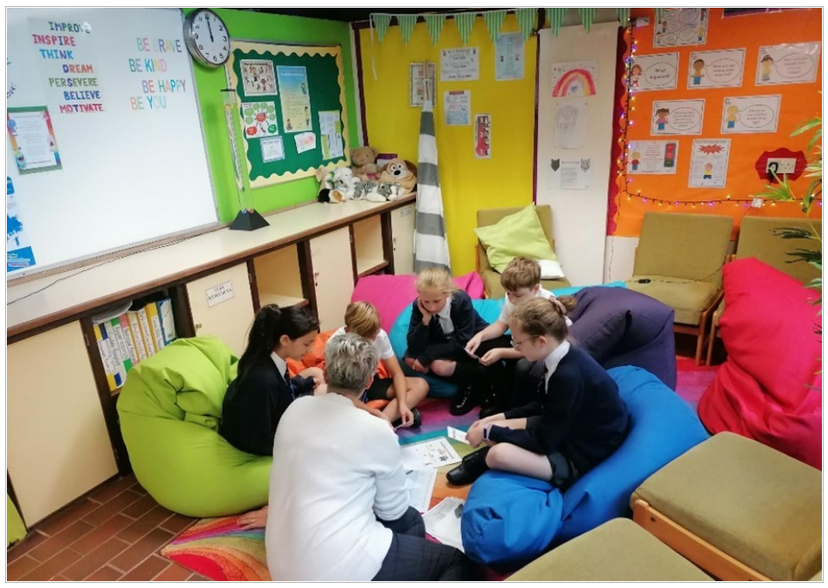
Senior mental health lead training feedback
“The training has been an invaluable way to draw together all my ideas and initiatives about having a whole school approach to Mental Health. I have learnt a lot through the modules offered and have enjoyed the way in which they are a mixture of practical tips, modelling and academic research."
Senior Lead from a college in East of England
Charlotte Read at Bosmere Junior School in Hampshire writes about her experience of senior mental health lead training in this blog.
"By pulling together everything we were already doing as a school community, and making a few small, but impactful changes, I was able to make sure that we are fully covering the eight aspects of a whole school approach to mental health and wellbeing. The school now has an improved support offer, and the training has been hugely helpful in identifying areas where more work is needed over the next year."
Charlotte Read, Bosmere Junior School, Hampshire
"The training helped us make decisions about mental health support that are tailored to our school’s needs and there was time to clarify ideas through the support of a dedicated coach, and deep dive into our provision and support."
Hannah Woodhouse, Moorlands Primary School in Huddersfield
Further information: Senior mental health lead training - GOV.UK (www.gov.uk)
Queries or feedback: MentalHealth.LeadTraining@education.gov.uk

Slide 7
Next steps
Speak to the relevant colleagues in your setting
Is your setting ready to take up this training opportunity before the end of this financial year?
Who is best placed to lead on the development of your whole school/college approach to mental health and wellbeing?
Click on the link to secure a grant this financial year. You can then look into the most suitable course for you.
Step 1
It takes 5 minutes to reserve a grant for 22/23 financial year
Form one – to confirm eligibility and allocate a grant

